Slide 1
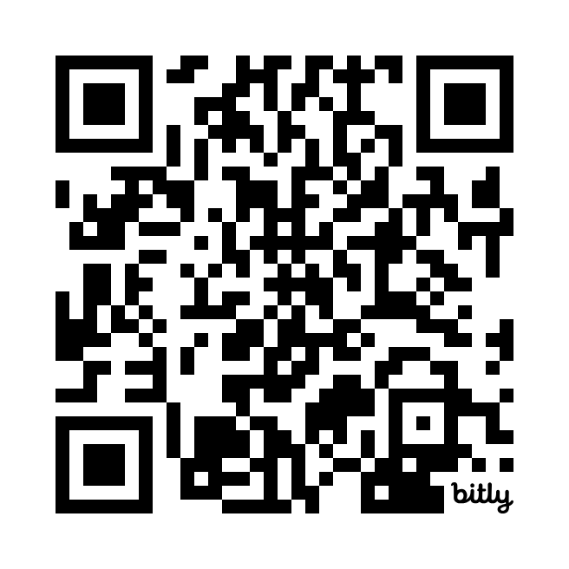
Shiny app for beginners
Xijin Ge @SDSU
Get ready:
Login to Posit.cloud (Or start RStudio locally, update if needed)
install.packages(“shiny”)
Login to Shinyapps.io
Copy files from https://BIT.LY/SDSUshiny

Slide 2
Basic concepts
Example
Building an app

Slide 3
Everything in R is an object.

Slide 4
R data types
Data objects
data structures
character
numeric
integer
logical
vectors
list
factor
matrix
data frame

Slide 5
If it is not a data object, it must be a function.
y <- sqrt(10^5 - 4.3)

Slide 6
A function can have many input parameters
plot(
x = 1:20,
y = rnorm(20),
main = ”Just a plot”,
las = 3,
xlab = ”x value”,
ylab = ”y value”
)

Slide 7
Define your function
square <- function(x){
x^2
}

Slide 8
Functions can take functions as input
plots <- function(fn){
x <- 1:50
plot(x, fn(x))
}
plots(square)

Slide 9
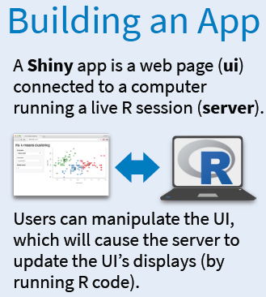

Slide 10
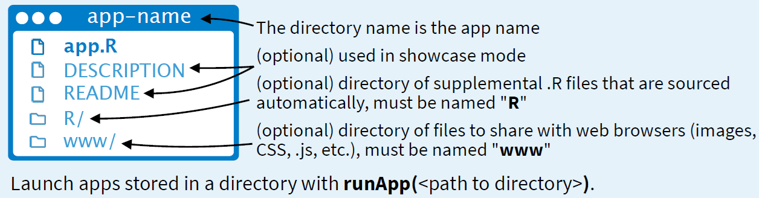

Slide 11
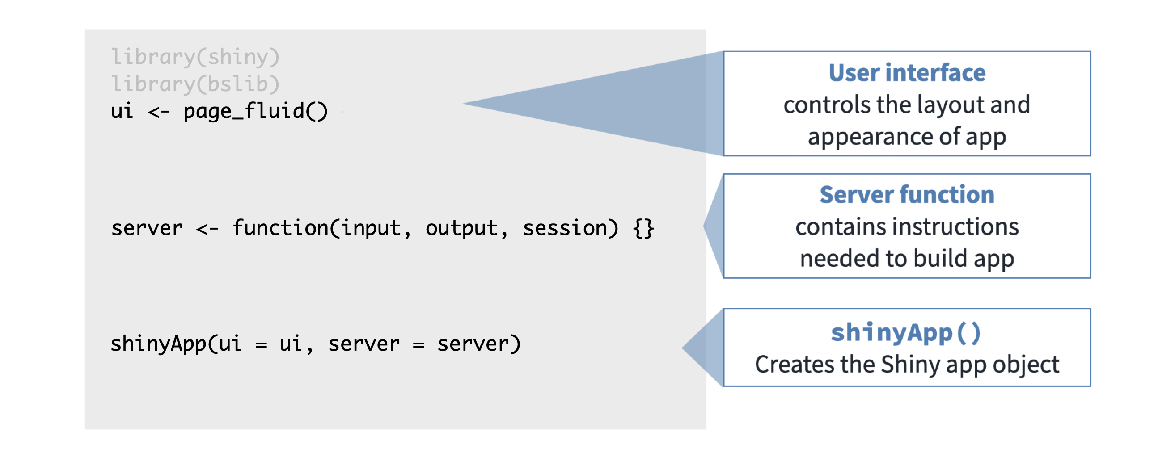

Slide 12
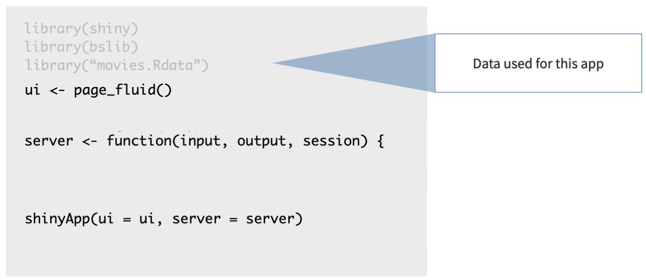

Slide 13
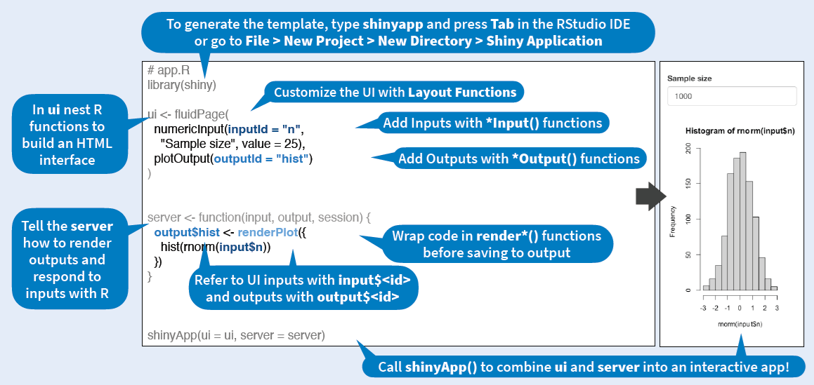

Slide 14
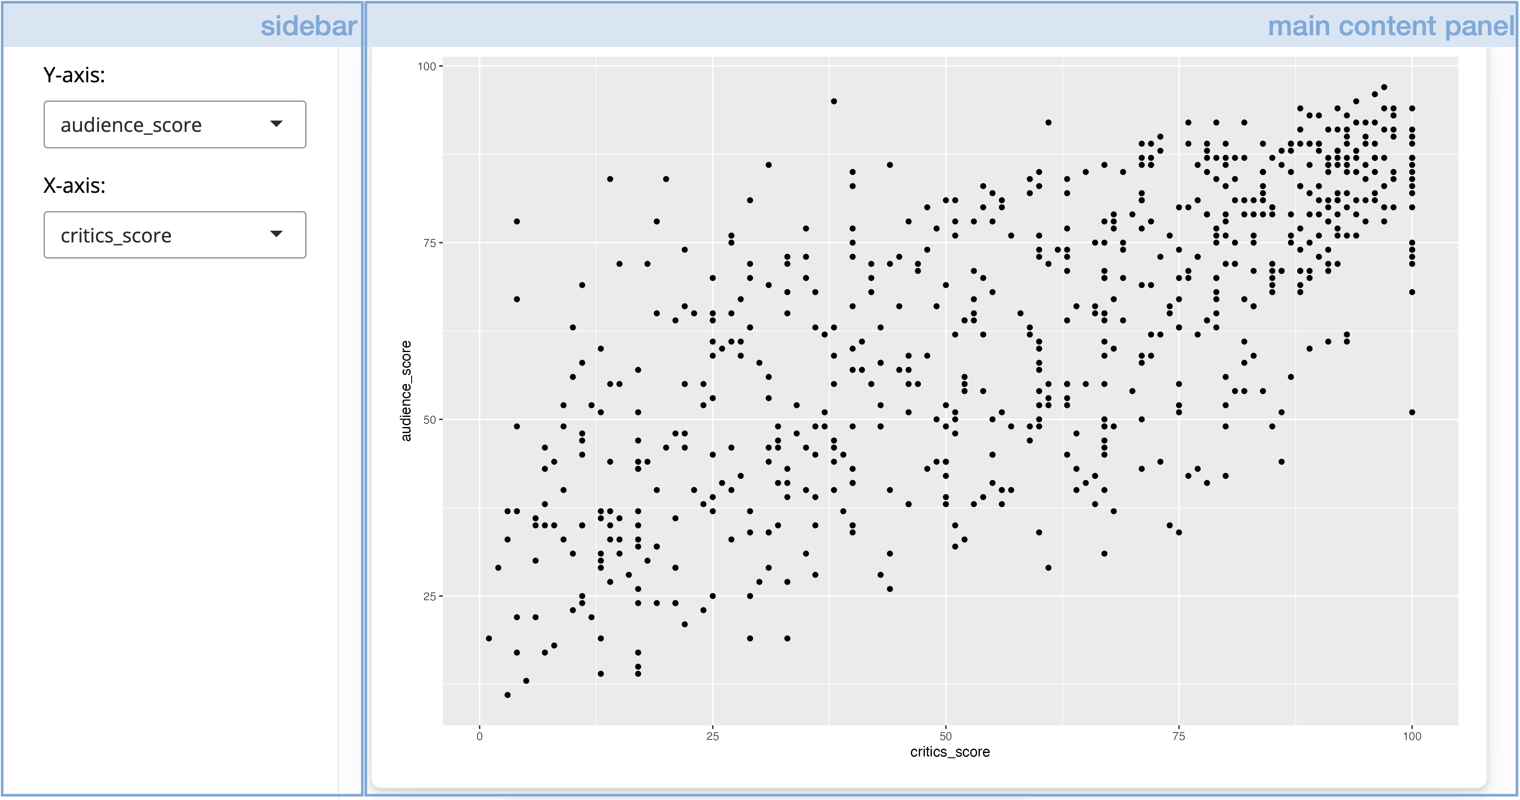

Slide 15
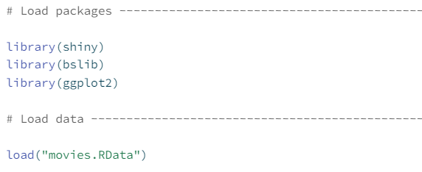

Slide 16
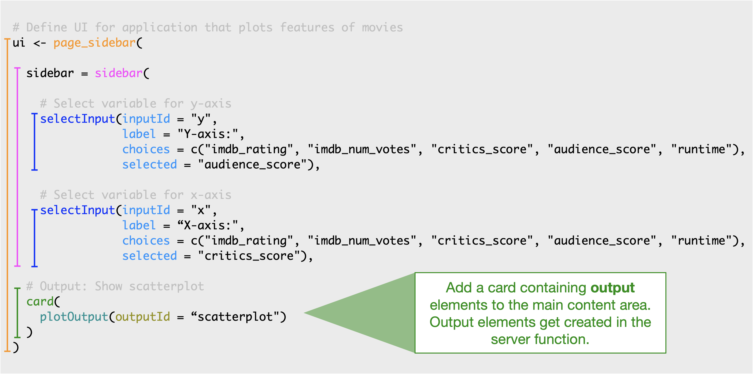

Slide 17
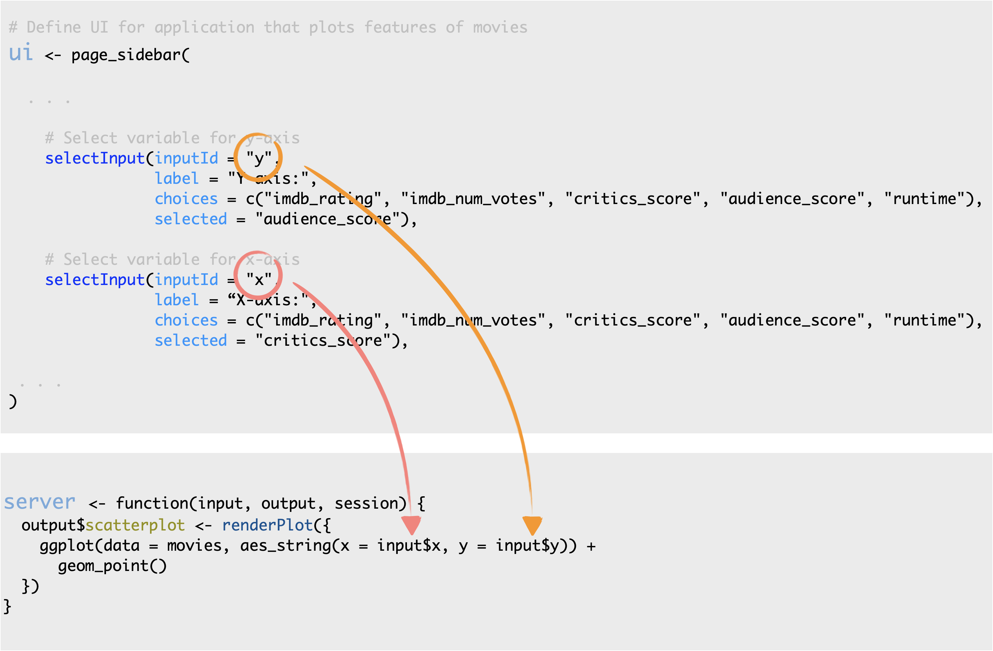

Slide 18
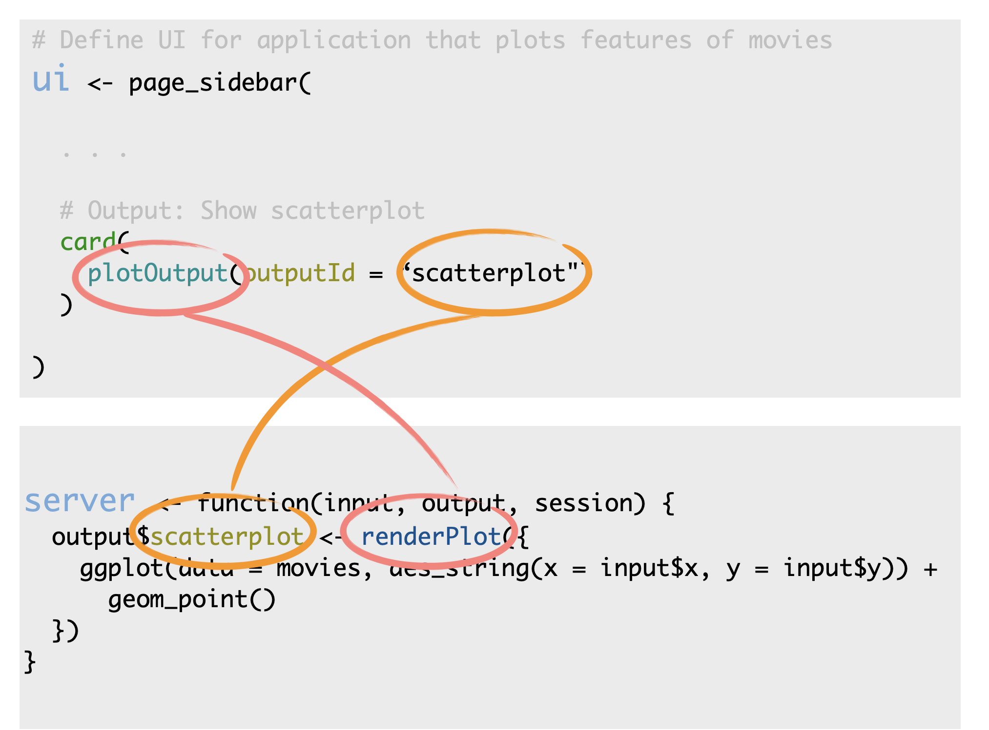

Slide 19
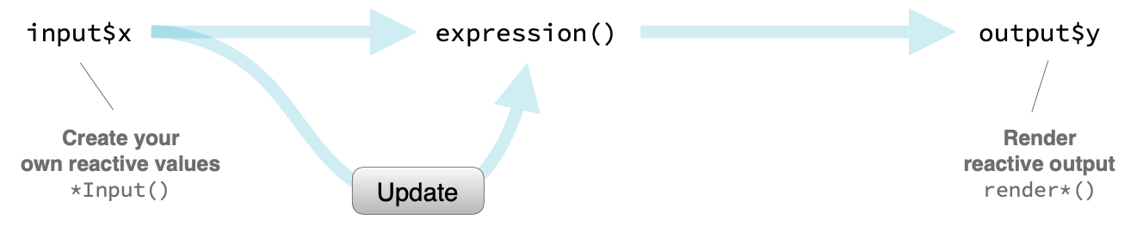

Slide 20
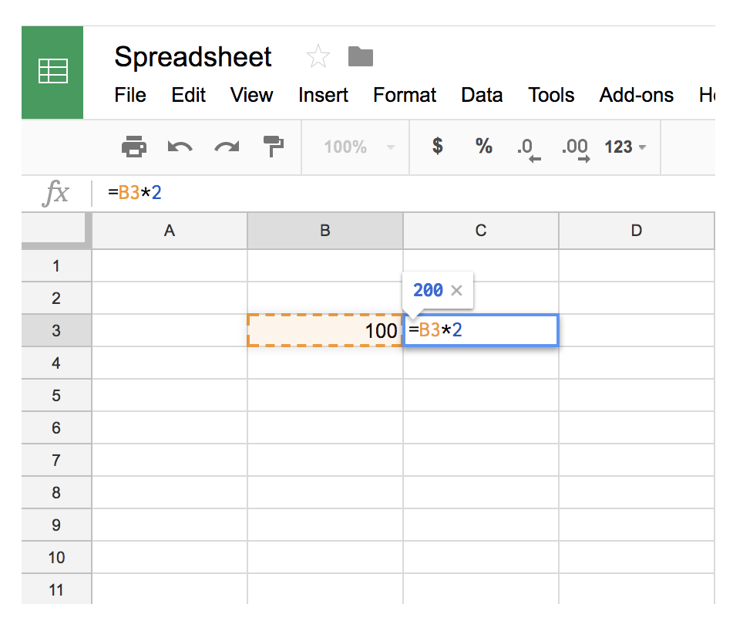
Reactivity

Slide 21
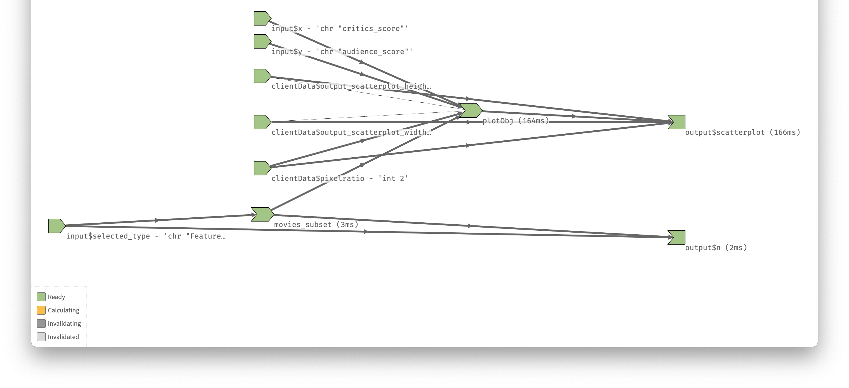
Reactivity logic can be complex:
Reactlog

Slide 22
Practical considerations
Start from an example. Modify to suit your needs.
Add UI elements first. Test then change the server logic.
Use the browser() function to debug.
Generate plots in another window. Transpl

Slide 23
Shiny apps are for others to use
Curse of knowledge
Assume others are stupid and lazy

